Slide 1
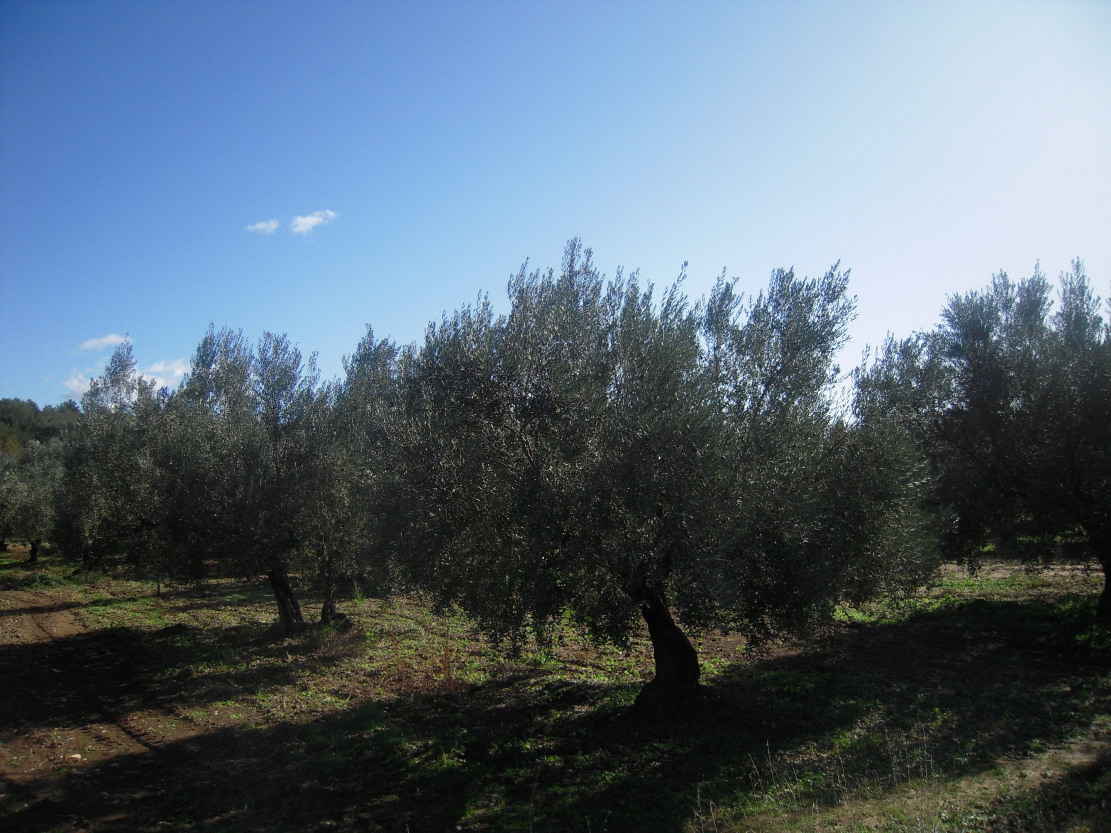



SEGORBE – ALTO PALANCIA 21/10/2015
ACTION STRATEGIES FROM THE RURAL PERSPECTIVE
Fernando Marco
direccion@cooperativaviver.es

Slide 2
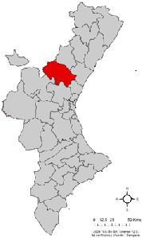
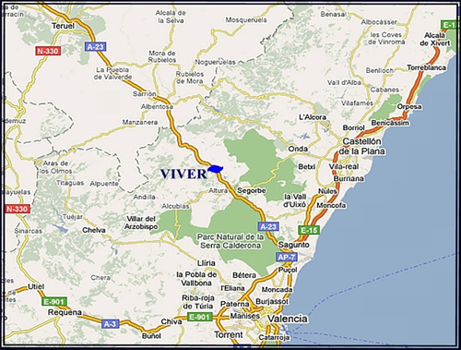
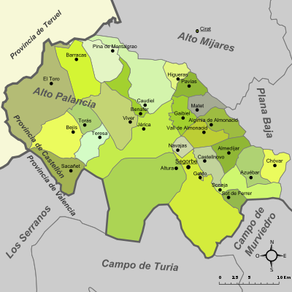
HERE WE ARE…
26.000
Citizens of the Worlds
Notes:
VIVER COMARCA DEL ALTO PALANCIA
1700 HABITANTES
A 70KM DE TERUEL, CASTELLÓN Y VALENCIA

Slide 3
OUR POPULATION
Segorbe | 9.267
Villa de Altura | 4.008
Viver | 1.754
Jérica | 1.642
Soneja | 1.476
Castellnovo | 1.080
Navajas | 733
Caudiel | 724
Geldo | 702
Sot de Ferrer | 471
Bejís | 452
Chóvar | 354
Azuébar | 343
Algimia de Almonacid | 321
El Toro | 309
Teresa | 303
Vall de Almonacid | 275
Almedíjar | 306
Torás | 250
Gaibiel | 213
Benafer | 179
Barracas | 179
Pina de Montalgrao | 151
Matet | 125
Sacañet | 100
Pavías | 57
Higueras | 54

Slide 4
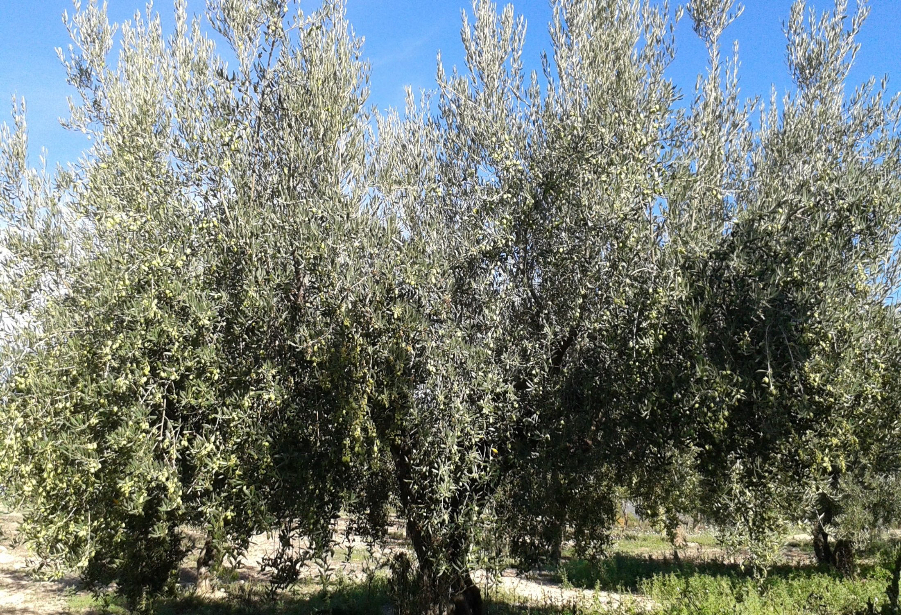
RURAL ENVIRONMENT ISSUES
LEADERSHIP SHORTAGE
LACK OF OPPORTUNITIES
ONGOING INERTIA

Slide 5
RURAL ENVIRONMENT OPPORTUNITIES
«SMALL IS COOL»
PECULIARITIES
NATURAL RESOURCES

Slide 6

OUR APPROACH AS ORGANISATION
- STRATEGIC VISION
- VALUES
- OPPORTUNITIES GENERATION
- DIVERSIFICATION
- FINANCIAL SOVEREIGNTY

Slide 7
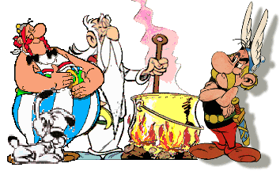
THE PROCESS ENGINES
PEOPLE WILL
Executive Board since 2002
MANAGING IDEAS
Professional team since 2004
Notes:
TODO ES POSIBLE SI CREEMOS LO SUFICIENTEMENTE EN ELLO Y TRABAJAMOS JUNTOS PARA LOGRARLO

Slide 8
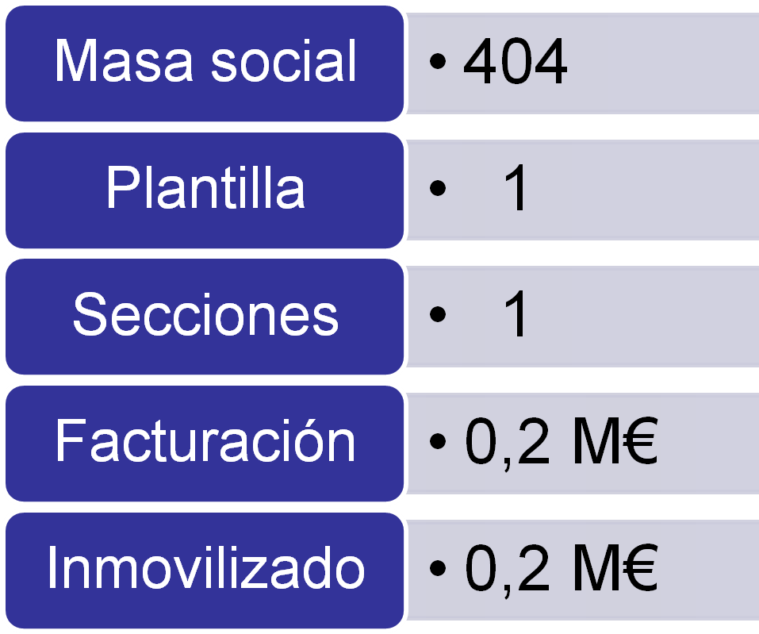
A COOPERATIVE WHICH HAS MATURED
2001 2015
471
35
5
6,4 M€
2,4 M€
Notes:
Membership
Workforce
Sections
Turnover
Fixed Assets

Slide 9

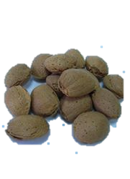
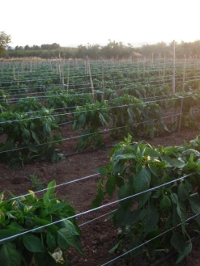
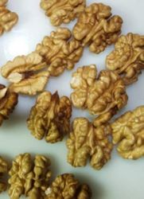
AGRARIAN «NUMBERS»
1.000.000 KG OLIVES
500.000 KG ALMONDS
100.000 KG HORTIFRUT
10.000 KG NUTS

Slide 10



Strategic Plan 2014-18
OUR STRATEGIC DOMAINS
THE MEMBER AND THE TERRITORY
- Member “hooligan”
- A visible Cooperative
AGRICULTURE
- To improve settlements
- New opportunities
DIVERSIFICATION
- Profitability of the Cooperative
- Services to the population

Slide 11
RENEWABLE ENERGIES IN OUR COOPERATIVE
SUNROOFS
BIOMASS
ENERGY CROPS CULTIVATION
Electricity production
40 kWp
Almond shells used as a fuel for boilers
Test (4 years) on the potential borne by energy crops cultivation

Slide 12
PRESENT AND FUTURE
AGRICULTURE
DIVERSIFICATION
TERRITORY
MEMBER
Olive oil
Almond
Nut
Vegetables
Agricultural services
Supply store
Fuel station
Supermarkets
Renewable Energies
Olive oil-related tourism
Management of other entities
Inter-cooperation
Support to associations
Help management
Telephony
Insurances
Training
Volunteer contributions
Other benefits
Participation
Dependence
Coop global member for all practical purposes
…
Compotes
Transformation of dried fruits
Aromátic plants
Wine
…
The regional challenge
Cooperative integration
Territory conservation
…
Energy services
Biomass
More supermarkets…

Slide 13
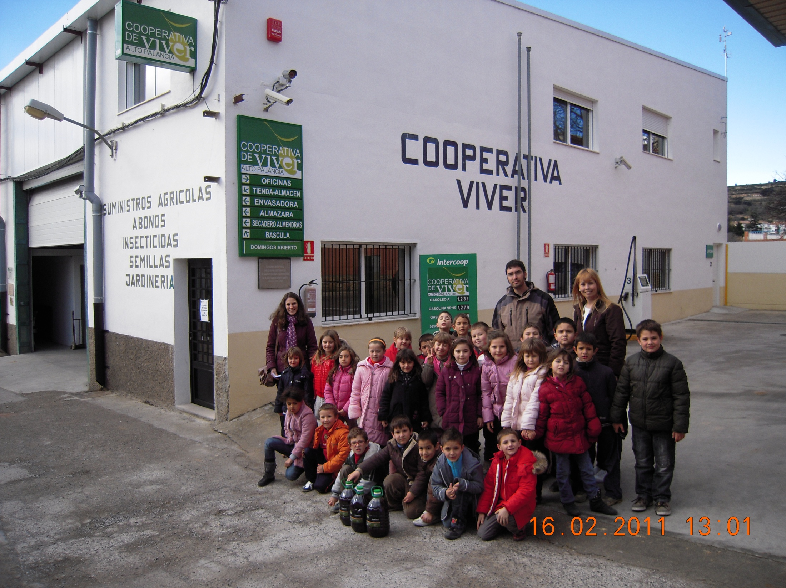

“Today is the first day of the future”
www.cooperativaviver.es

